Slide 1
Some Tips on using Tableau
And Thoughts on Approaches to
Performance Measurement
Skip Krueger, PhD
July 17, 2026

Slide 2
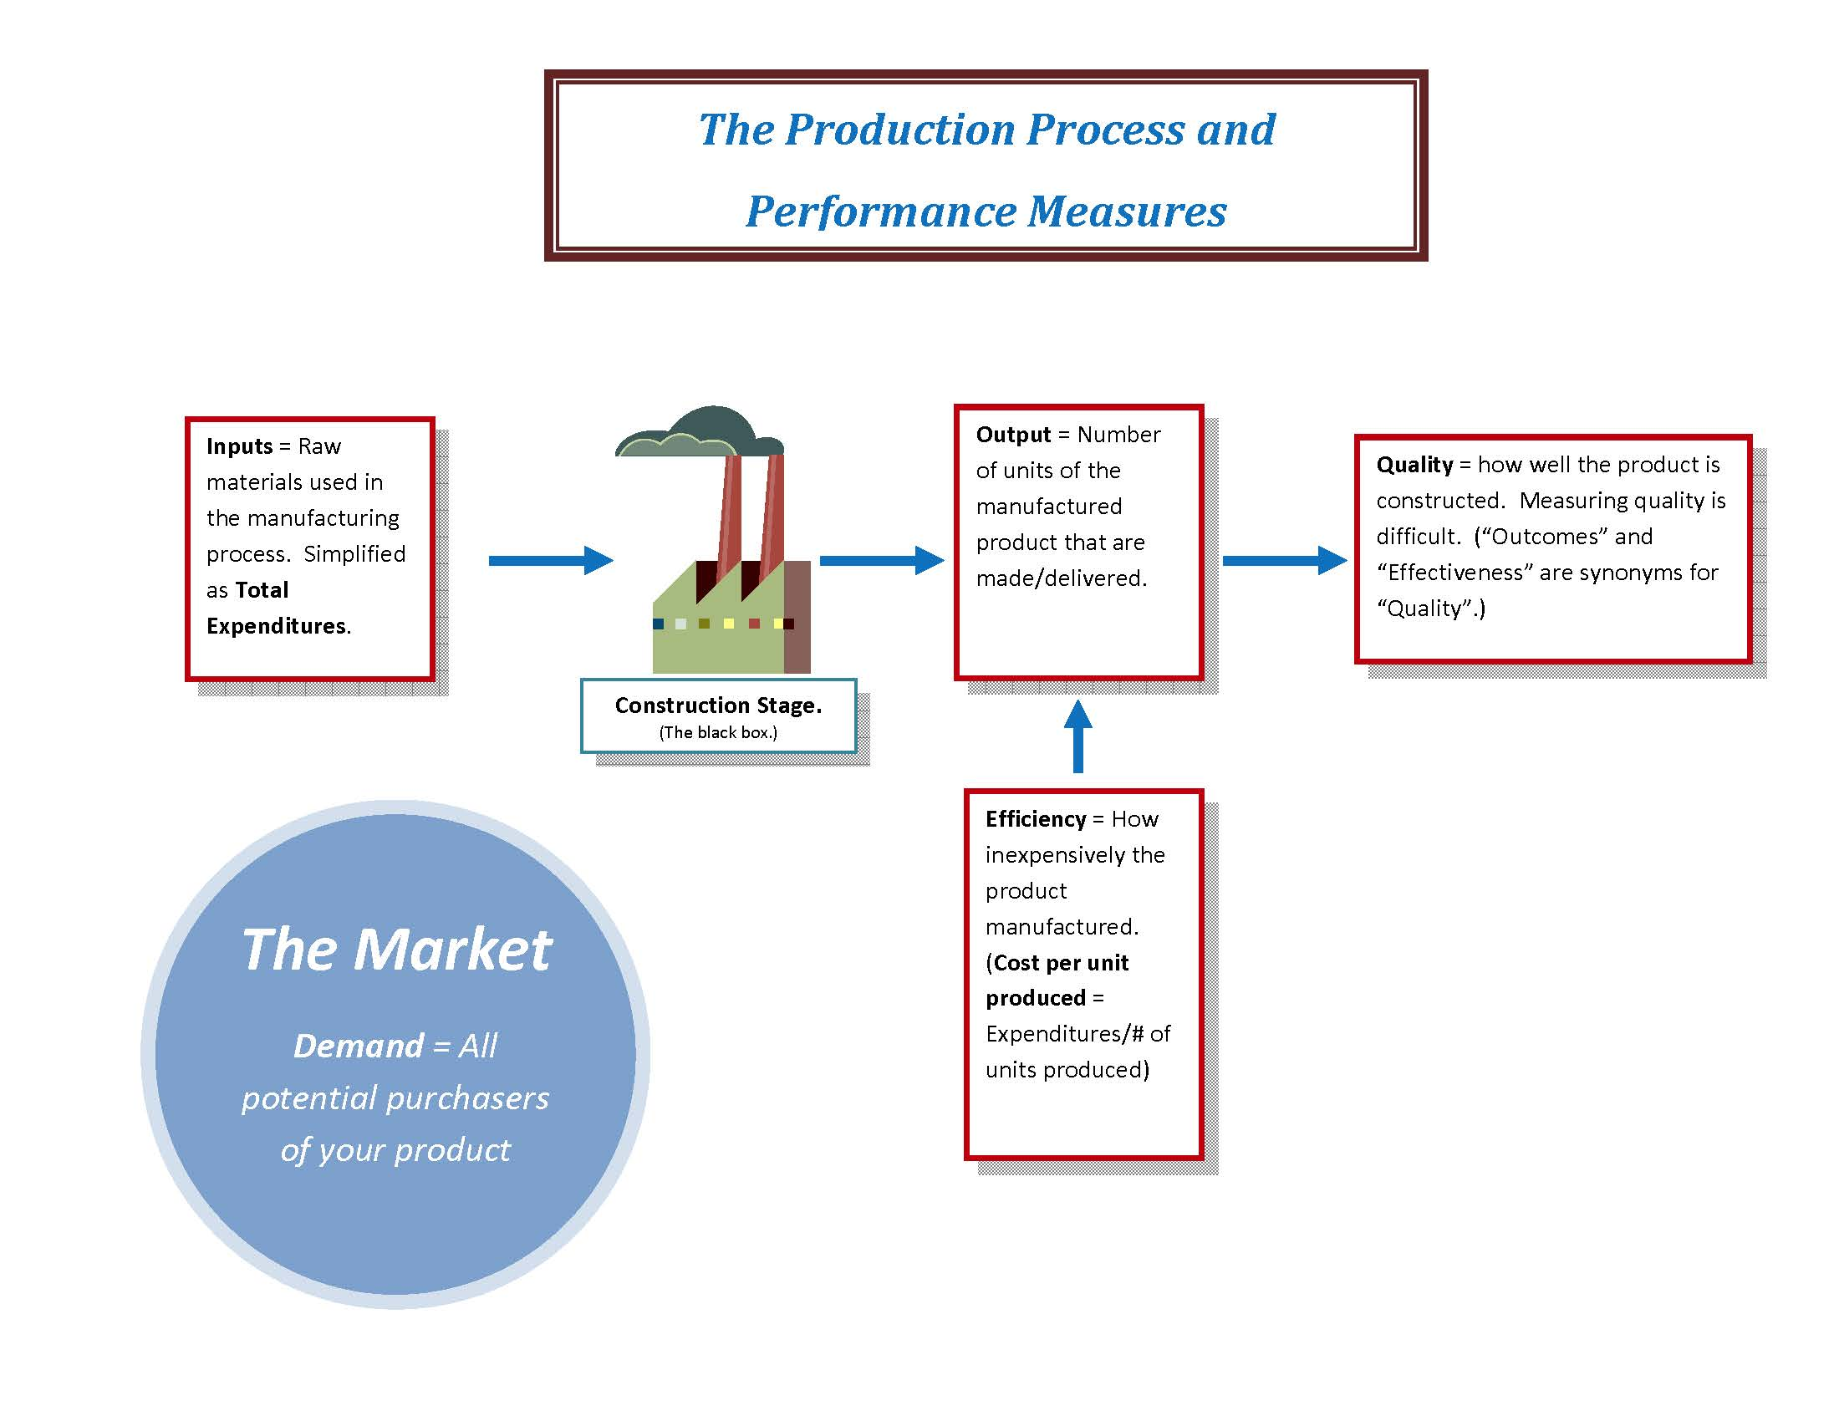
Where it all started

Slide 3
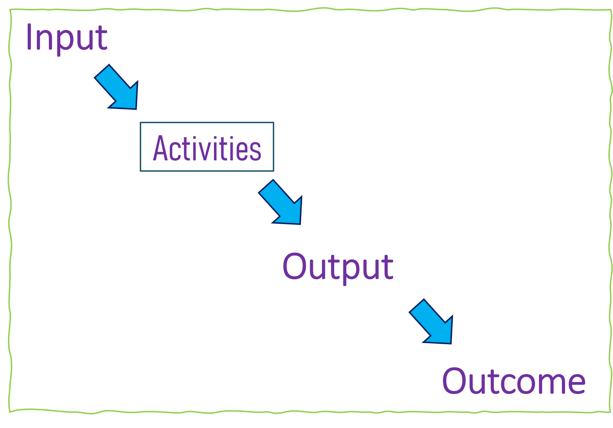
The “Logic Model” in Our World
The “logic” of the Logic Model is a set of assumptions.
The assumptions may or may not be right for your jurisdiction at that point in time.
Even if true in the research literature generally.
So, Performance Measurement has two jobs:
Check those assumptions.
Track that the organization is meeting it’s promised performance goals.
Assumption 1:
This much money will pay for this much Activity.
Assumption 2:
This much activity will give this many Outputs.
Assumption 3:
This many Outputs will lead to this change in society (measured as Outcomes/ Effectiveness/Quality)

Slide 4
Developing the Logic: Work the logic model backwards
What social impact do we want?
What is the best way to get to that social impact?
What activities will provide those outputs?
What is the best way to organize to implement those activities and how much will it cost?
Outcomes
Outputs
Activities
Inputs

Slide 5
Decision-Driven Analytics
The new Nerd Cool
Trend: Outcomes (back) in focus
This trend is driving a greater focus on impacts to communities
Asking the HARDEST question: What value added is Performance Measurement providing?
Cost vs Quality:
In addition to focusing on what the community needs/wants, it helps sharpen the discussion of the trade-off between price (efficiency) and quality (outcome/effectiveness).
Do ALL programs need to be Lexus-level? Is it ok to fund some programs as Hondas?
Needs of the Decisions steer the boat
Turns the conversation from data-driven decisions and to ways in which data analytics can help (but not be the sole issue) with difficult decisions
Maybe especially at the level of policy, strategic planning, budgets

Slide 6
OK, let’s do this
Go to:
github.com/skipkrueger
emojidb.org

Slide 7
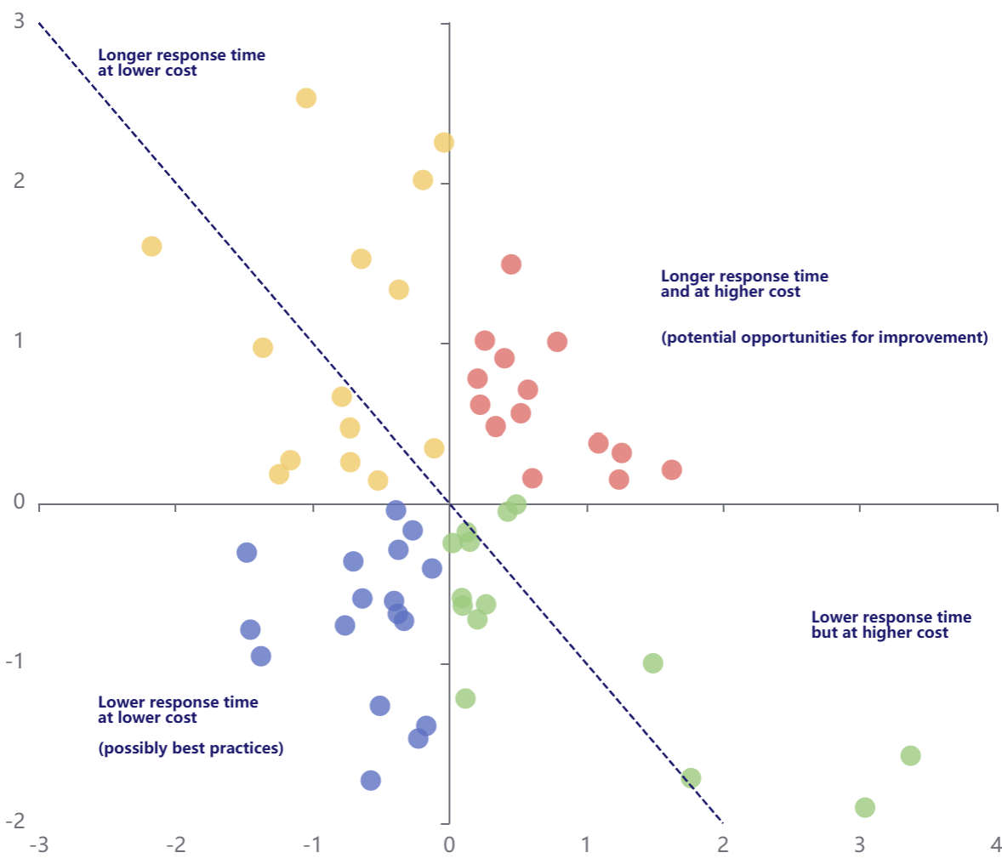
Links to some helpful information
Github dataset
Emojis
Unicode Symbols
HTML Color Codes
Data Visualization for Readers experiencing Color Blindness
Comparative Outcomes
Flower Mound

Slide 8
Things to consider and opportunities to seek
Big Picture:
Visualizations:
Audience – policy vs mgmt, senior mgmt vs dept staff
Aggregations – time, type, teams
Outputs vs Outcomes – can you find at least short-term outcomes to quantify quality and does it do better than bars of soap?
Set up Fiscal Years – helps keep outputs/outcomes connected to budget (inputs)
Symbols –help keep it simple
Trends – direction over time is key
Filters – can be so helpful
Tool tips – unique information
Labels – if it’s not necessary, it goes
Decision-Driven Analytics:
What decisions do you want the data to help with?
Let this guide your choices

Slide 9

Please stay in touch
vCard:
Email:
Skip@KruegerConsulting.io
Text:
206-486-5749
LinkedIn:
https://www.linkedin.com/in/skip-krueger-39a3b9153/
Thanks for letting me join you today!

